Slide 1
Hands on introduction to ancient microbiome analysis
Maxime Borry - August 18th 2021

Slide 2

Teaching material
tinyurl.com/ancientmicrobiome

Slide 3








Who am I ?
Maxime Borry - Doctoral researcher at MPI-SHH - MPI-EVA
Ancient DNA microbiome bioinformatics
@notmaxib
@maxibor
maximeborry.com

Slide 4








How do we analyze microbiomes ?
microbes
DNA
sequencing
FASTQ
taxonomic profiler
reference
database
ATCGGCAGTC...
 | microbe_1 | microbe_2 | ... | microbe_n
sample_1
sample_2
...
sample_n
samples
taxonomic profile

Slide 5

How do we analyze ancient microbiomes ?
ancientDNA
sequencing
FASTQ
taxonomic profiler
reference
database
ATCGGCAGTC...
 | microbe_1 | microbe_2 | ... | microbe_n
sample_1
sample_2
...
sample_n
ancient samples
taxonomic profile

Slide 6
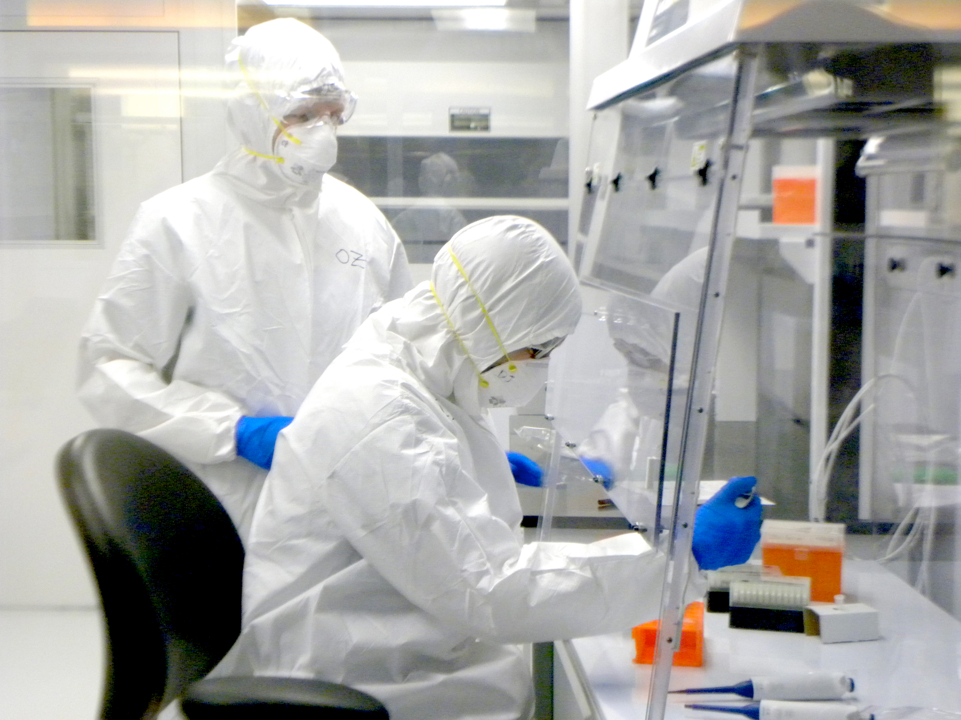
How do we analyze ancient microbiomes ?
ancientDNA
sequencing
FASTQ
taxonomic profiler
reference
database
ATCGGCAGTC...
 | microbe_1 | microbe_2 | ... | microbe_n
sample_1
sample_2
...
sample_n
ancient samples
taxonomic profile

Slide 7
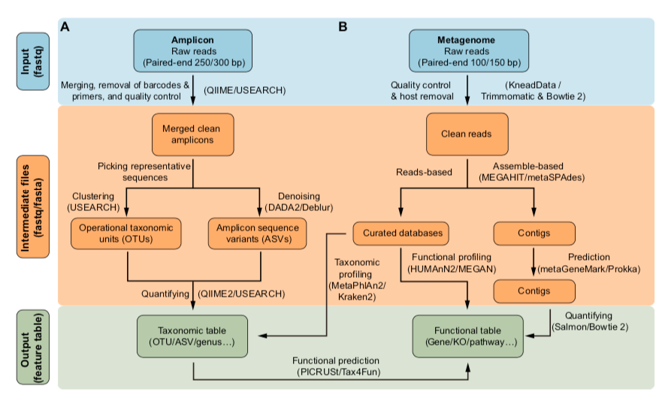
More in details
Liu Y-X, Qin Y, Chen T, Lu M, Qian X, Guo X, Bai Y. 2021. A practical guide to amplicon and metagenomic analysis of microbiome data. Protein & Cell 12:315–330. DOI: 10.1007/s13238-020-00724-8.

Slide 8

Ambiguity in taxonomic assignation
sequence 1 ATGGTCGGGCAGGACGTTGCGAGT
sequence 2 CGAGAAGGGCAGGACGCCACGTAC
ATGGTCGGGCAGGACGTTGCGAGT
CGAGAAGGGCAGGACGCCACGTAC

Slide 9
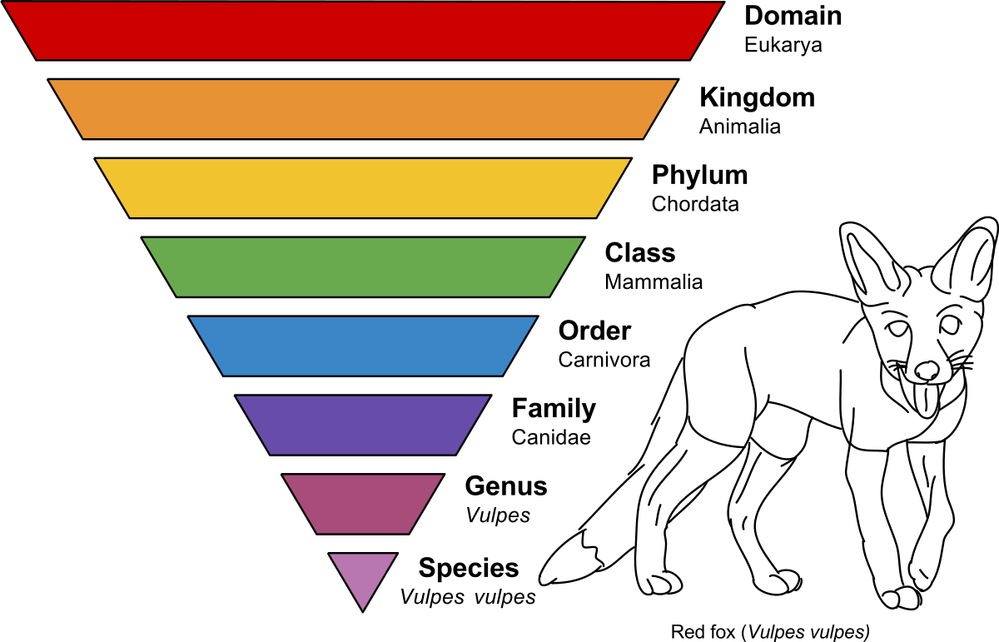
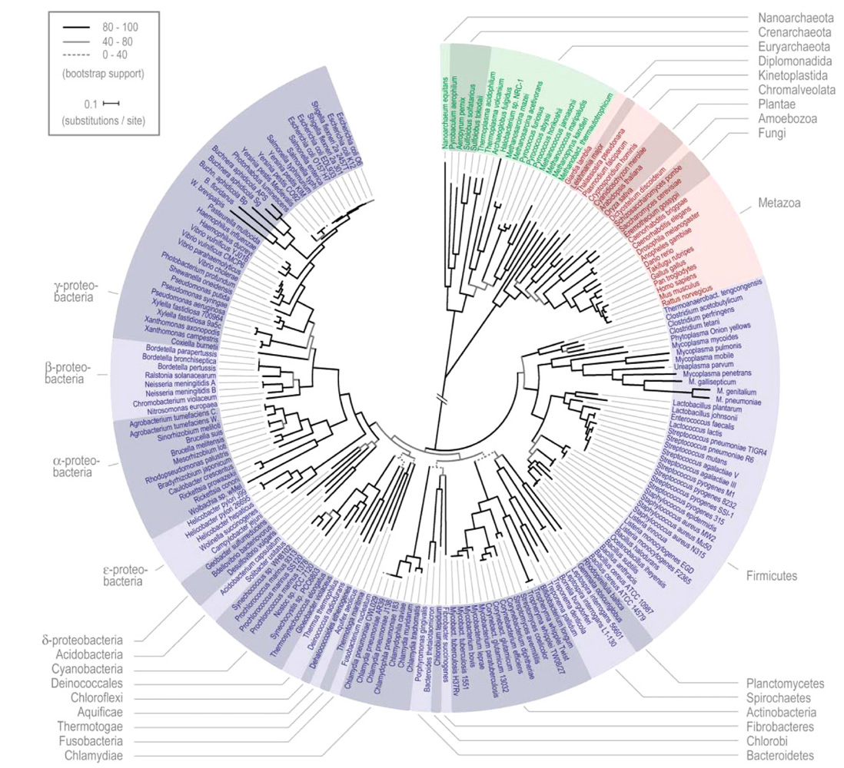
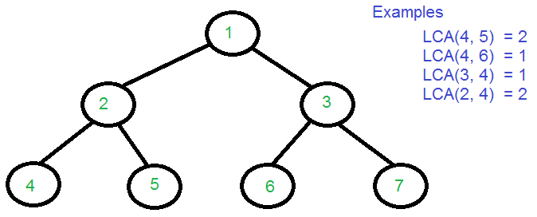
Taxonomy and LCA to the rescue
Species level assignation is not always possible.
Possibility of hits in different species
Ambiguities solved by LCA (Lowest Common Ancestor) algorithm.

Slide 10
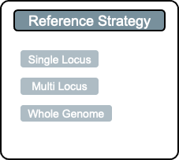
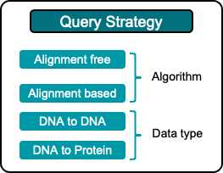
Different taxonomic profilers
maximeborry.com/courses : “Taxonomic classifiers and sequence alignment algorithms”

Slide 11
(most common) taxonomic profilers used in aDNA
Kraken2
No alignment
Fast
Lower specificity (more false positives)
MetaPhlAn
Custom curated marker database
Reasonably fast
Good balance between specificity and sensitivity
MALT
Alignements
Slower
Resource hungry
Best balance between specificity and sensitivity
Taxonomic profilers benchmark (and more): CAMI challenge

Slide 12
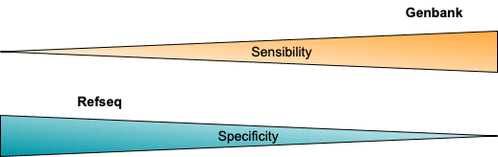
Reference databases
NCBI databases
NCBI nr/nt
the largest database
NCBI RefSeq
A curated subset
Custom databases
Metaphlan: clade specific markers

Slide 13
How is aDNA microbiome different from “modern” microbiome analysis ?
We have to show our sample is what we claim it to be:
time period
Is it actually ancient ?
Isotopic dating
source
Is it from the correct host ?
microbiome profile, host DNA
Is it from the correct ecological niche ?
microbiome profile
contamination
How much of the sample is endogenous ?
taxonomic composition of bacteria carrying deamination damage
Is there a lot of modern contamination (excavation, lab, ...) ?
taxonomic composition of non deamination damaged bacteria

Slide 14
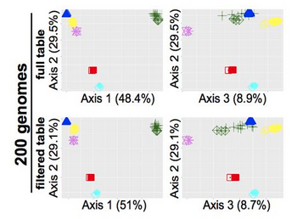
How does aDNA damage affect taxonomic profiling ?
Damage isn’t really an issue
PCoA of simulated community composition with Weighted-Unifrac Distance
Velsko, Irina M., et al. "Selection of appropriate metagenome taxonomic classifiers for ancient microbiome research." Msystems 3.4 (2018): e00080-18.
But very short sequences are more problematic
Notes:
Time for the 1st Poll

Slide 15
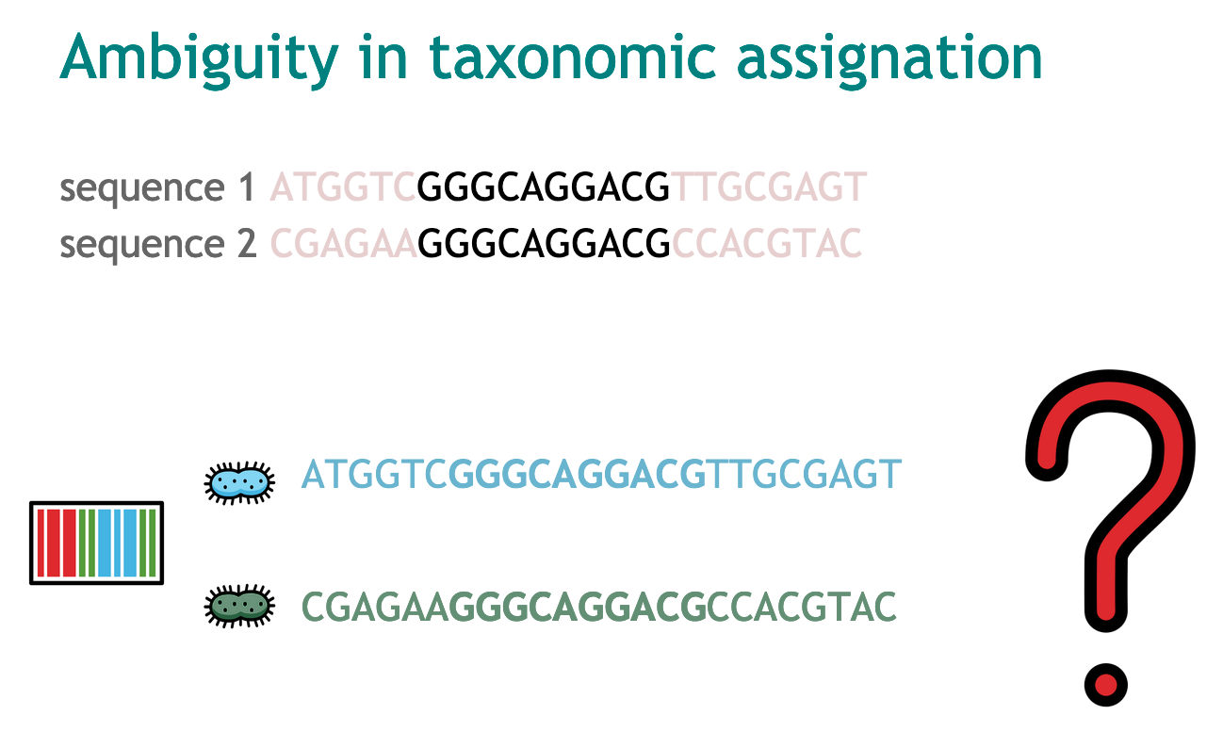
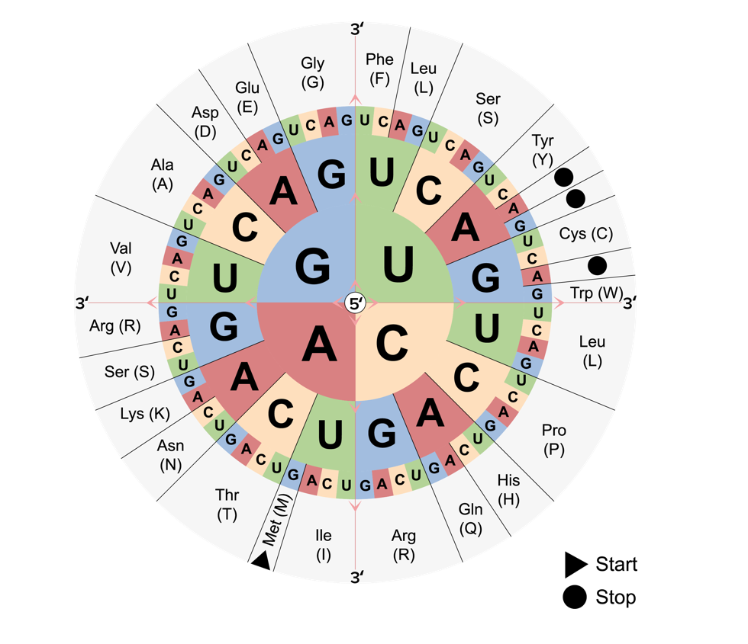
The problem with short sequences
3 DNA bases = 1 amino acid
16s rRNA amplification/sequencing is not very good
Protein alignment is not good enough for very short sequences
Velsko, Irina M., et al. "Selection of appropriate metagenome taxonomic classifiers for ancient microbiome research." Msystems 3.4 (2018): e00080-18.
Orlando, Ludovic, et al. "Ancient DNA analysis." Nature Reviews Methods Primers 1.1 (2021): 1-26.

Slide 16
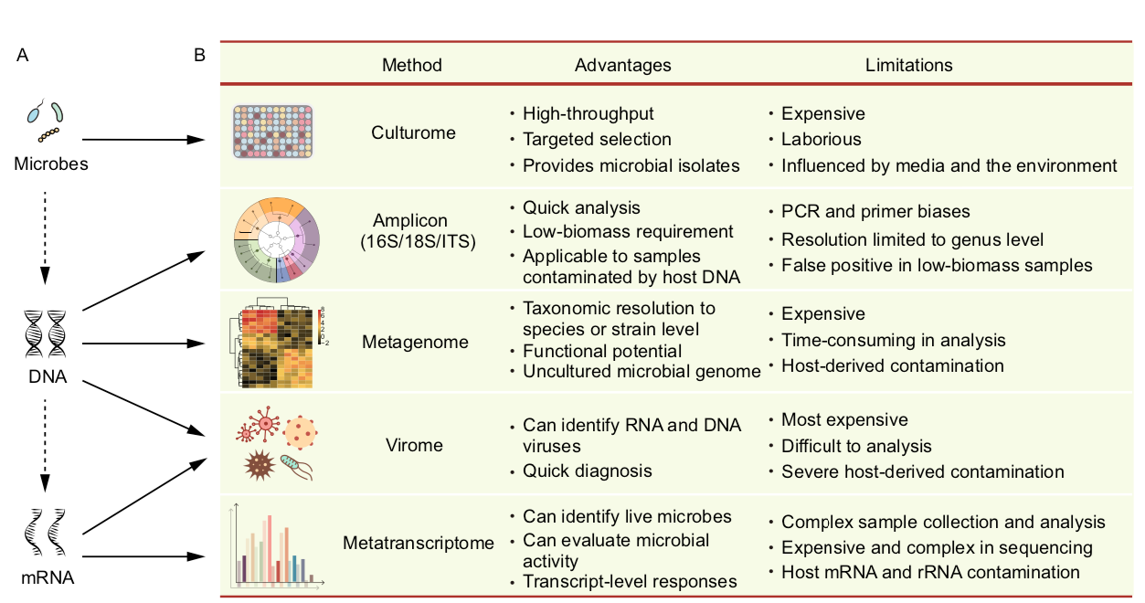
aDNA vs modern microbiome
Liu Y-X, Qin Y, Chen T, Lu M, Qian X, Guo X, Bai Y. 2021. A practical guide to amplicon and metagenomic analysis of microbiome data. Protein & Cell 12:315–330. DOI: 10.1007/s13238-020-00724-8.

Slide 17
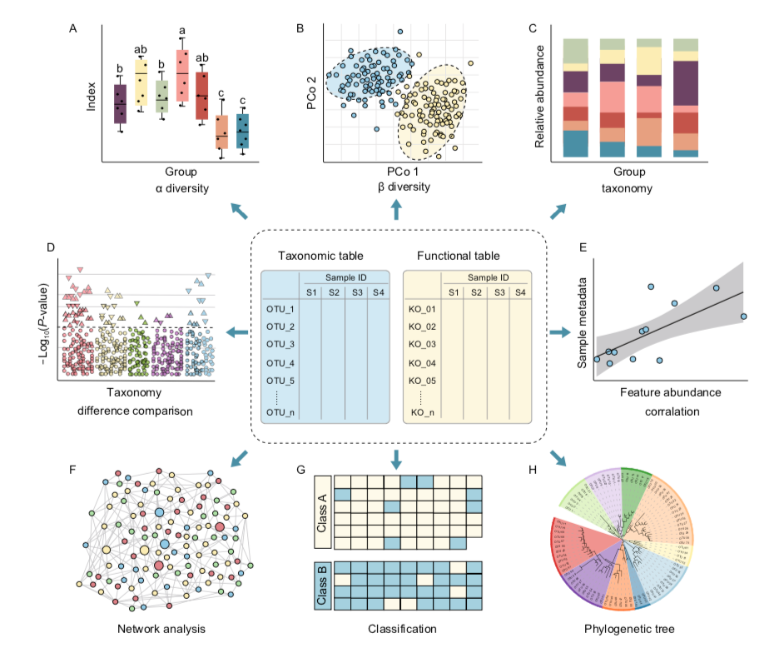
What will we get today ?
Liu Y-X, Qin Y, Chen T, Lu M, Qian X, Guo X, Bai Y. 2021. A practical guide to amplicon and metagenomic analysis of microbiome data. Protein & Cell 12:315–330. DOI: 10.1007/s13238-020-00724-8.

Slide 18
Questions and tutorial !
tinyurl.com/microbiometutorial

